Slide 1
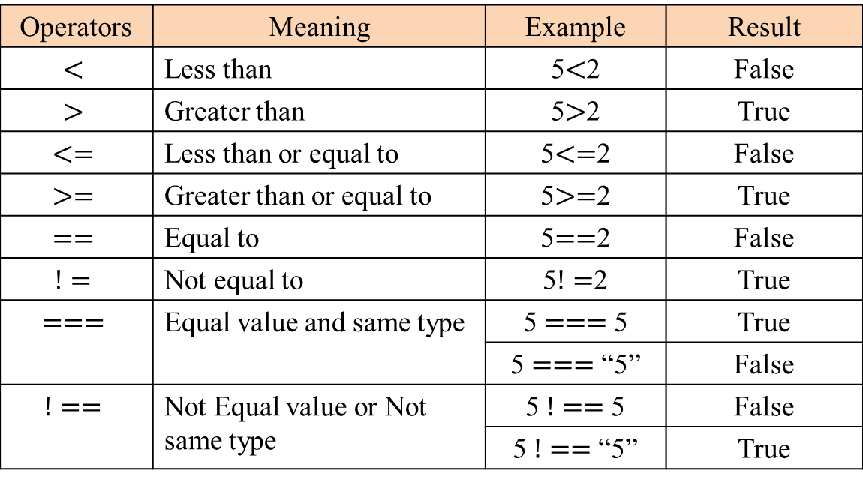
Relational Operators
Operators | Meaning | Example | Result
$$<$$ | Less than | 5$<$2 | False
$$>$$ | Greater than | 5$>$2 | True
$$<=$$ | Less than or equal to | 5$<=$2 | False
$$>=$$ | Greater than or equal to | 5$>=$2 | True
$$==$$ | Equal to | 5$==$2 | False
$$!=$$ | Not equal to | 5$!=$2 | True
$$===$$ | Equal value and same type | 5 $===$5 | True
 |  | 5 $===$“5” | False
$$!==$$ | Not Equal value or Not same type | 5 $!==$5 | False
 |  | 5 $!==$“5” | True

